Slide 1



IBM HR Analytics Employee Attrition & Performance Trends
This presentation analyzes employee attrition and performance using IBM HR Analytics data. The goal is to identify key factors influencing employee turnover and retention strategies. Prepared by Vaibhav
by Nai vaibhav

Slide 2
Project Objectives
Understand Factors Affecting Employee Attrition
Identify Trends in Employee Performance
Provide Data-Driven Insights for HR Decision-Making
Identify the variables influencing employee turnover decisions, like salary, job satisfaction, work-life balance, and company culture.
Analyze performance data to uncover patterns and trends in employee engagement, productivity, and effectiveness across different departments and job roles.
Offer actionable insights based on data analysis to inform HR policies, strategies, and interventions aimed at improving employee retention and performance.

Slide 3

Exploratory Data Analysis (EDA)
Examined Demographic & Job-Related Features
Identified Patterns in Attrition and Performance Scores
Analyzed employee data like age, gender, education, job role, department, and experience to identify patterns and correlations.
Investigated relationships between employee characteristics and attrition rates, as well as the correlation between performance scores and factors like job satisfaction and workload.
Used Statistical Summaries & Visualizations for Insights
Employed descriptive statistics, like mean, median, and standard deviation, to summarize data, and created visualizations, like bar charts, scatter plots, and histograms, to visualize trends and patterns.

Slide 4

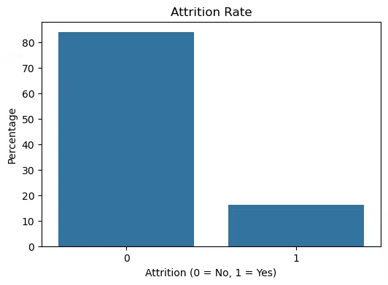
Job Role vs. Attrition Rate
Sales Representative
Laboratory Technician
The highest attrition rate among all roles, suggesting potential issues like high workload, lack of career growth, or insufficient compensation.
Second highest attrition rate, possibly due to factors like challenging work environment, lack of recognition, or limited advancement opportunities.
Research Scientist
Relatively low attrition rate, suggesting a more fulfilling work environment and stronger retention strategies for this particular role.

Slide 5

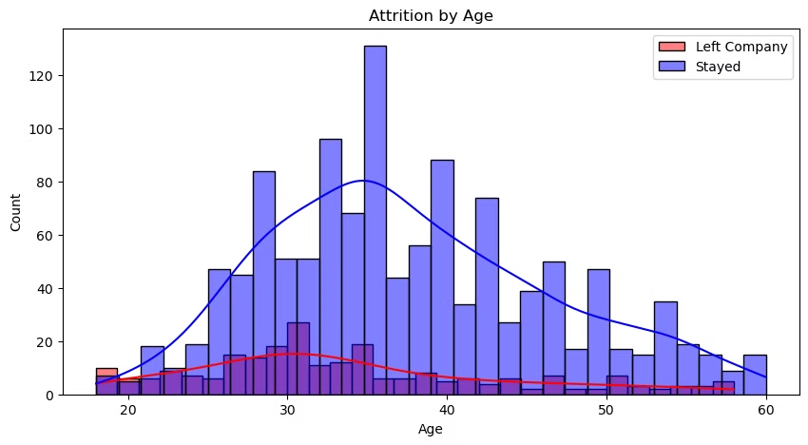



Employee Attrition Breakdown
Age
Salary
Job Satisfaction
Employees under 30 years old show a higher attrition rate compared to older employees. This might indicate challenges with younger workers finding stability or seeking growth opportunities.
Employees with lower salaries tend to have higher attrition rates. This emphasizes the importance of competitive compensation for attracting and retaining talent.
Employees with lower job satisfaction are more likely to leave. This underscores the need for strategies promoting employee engagement and well-being.

Slide 6

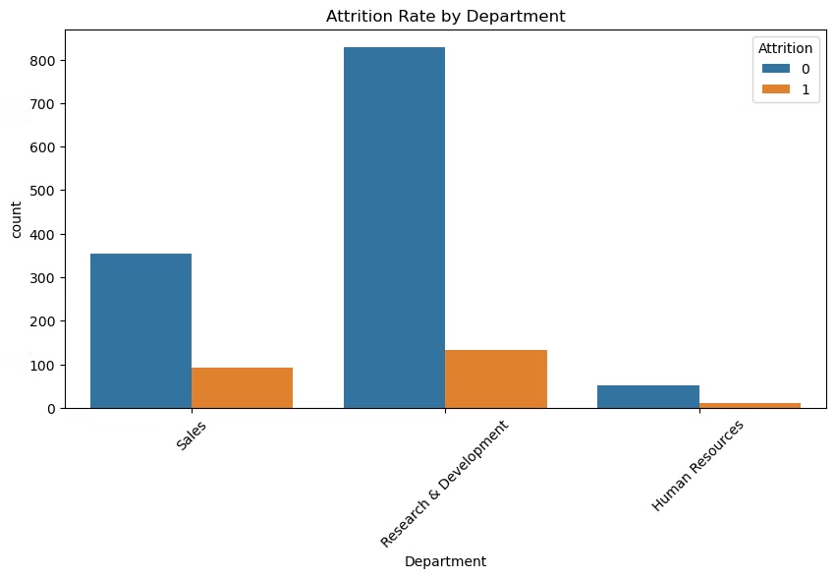
Salary & Attrition Distribution
1
Attrition Concentration
The distribution shows a greater concentration of attrition within lower salary brackets. This suggests salary plays a significant role in employee retention, particularly at lower salary levels.
2
Salary Impact on Attrition
While higher salaries may not completely eliminate attrition, they can mitigate its impact by attracting and retaining talented employees.
3
Implications for Compensation Strategy
HR should consider implementing competitive compensation strategies that address salary discrepancies and reward high-performing employees to minimize attrition risks.

Slide 7


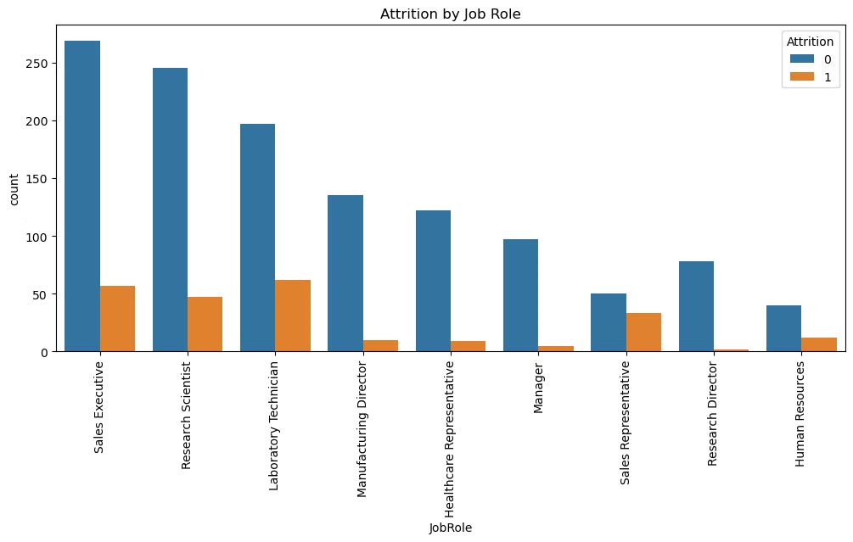


Correlation Between Employee Factors
Job Satisfaction & Attrition
A strong negative correlation indicates that lower job satisfaction significantly contributes to employee turnover.
Work-Life Balance & Attrition
A notable negative correlation suggests that employees struggling with work-life balance are more likely to leave.
Salary & Attrition
A weak negative correlation suggests that salary may play a role in attrition, but other factors have a more significant impact.

Slide 8

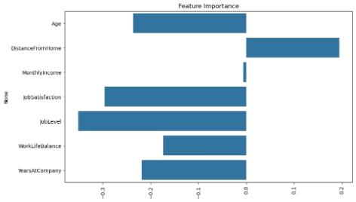
Feature Importance Analysis
Years Since Last Promotion
Work-Life Balance
A crucial factor, demonstrating the importance of career progression and opportunities for advancement in employee retention.
Job Satisfaction
A significant factor, indicating that providing flexible work arrangements and promoting a healthy work-life balance is crucial for retention.
The most significant factor contributing to attrition, highlighting the need for strategies to boost employee morale and engagement.

Slide 9
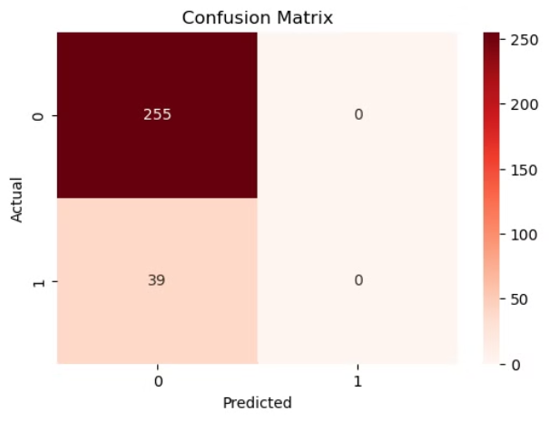




Confusion Matrix for Employee Attrition
True Positives
True Negatives
False Positives
False Negatives
The model correctly predicted that employees would leave the company. This helps identify employees at risk and enables early interventions.
The model correctly predicted that employees would remain with the company, indicating its accuracy in identifying loyal employees.
The model incorrectly predicted that employees would leave, which could lead to unnecessary interventions.
The model incorrectly predicted that employees would stay, potentially missing opportunities for early intervention and retention efforts.

Slide 10

Key Insights from Analysis
1
2
3
Younger Employees
Work-Life Balance & Job Satisfaction
Salaries & Promotions
Higher attrition rates among younger employees underscore the need for targeted retention strategies that address their specific needs and aspirations.
The significant impact of work-life balance and job satisfaction on retention emphasizes the importance of policies that support employee well-being.
Employees with lower salaries and fewer promotions are more likely to leave, highlighting the need for competitive compensation and career growth opportunities.
Conclusion & Recommendations - Implement better career growth opportunities - Improve work-life balance policies - Offer competitive salaries to reduce turnover
Future Work - Extend analysis with Machine Learning models - Explore external factors influencing attrition - Conduct real-time sentiment analysis on employee feedback

